Slide 1
Docker overview
Docker is an open platform for developing, shipping, and running applications. Docker enables you to separate your applications from your infrastructure so you can deliver software quick
https://www.weave.works/blog/a-practical-guide-to-choosing-between-docker-containers-and-vms

Slide 2
The Docker platform
Docker provides the ability to package and run an application in a loosely isolated environment called a container. The isolation and security allow you to run many containers simultaneously on a given host. Containers are lightweight and contain everything needed to run the application, so you do not need to rely on what is currently installed on the host.
Develop your application and its supporting components using containers.
The container becomes the unit for distributing and testing your application.
When you’re ready, deploy your application into your production environment, as a container or an orchestrated service. This works the same whether your production environment is a local data center, a cloud provider, or a hybrid of the two.

Slide 3
What can I use Docker for?
Your developers write code locally and share their work with their colleagues using Docker containers.
They use Docker to push their applications into a test environment and execute automated and manual tests.
When developers find bugs, they can fix them in the development environment and redeploy them to the test environment for testing and validation.
When testing is complete, getting the fix to the customer is as simple as pushing the updated image to the production environment.

Slide 4
Docker architecture
Docker uses a client-server architecture. The Docker client talks to the Docker daemon, which does the heavy lifting of building, running, and distributing your Docker containers. The Docker client and daemon can run on the same system, or you can connect a Docker client to a remote Docker daemon. The Docker client and daemon communicate using a REST API, over UNIX sockets or a network interface. Another Docker client is Docker Compose, that lets you work with applications consisting of a set of containers.

Slide 5
The Docker daemon & The Docker client
The Docker daemon (dockerd) listens for Docker API requests and manages Docker objects such as images, containers, networks, and volumes. A daemon can also communicate with other daemons to manage Docker services.
The Docker client (docker) is the primary way that many Docker users interact with Docker. When you use commands such as docker run, the client sends these commands to dockerd, which carries them out. The docker command uses the Docker API. The Docker client can communicate with more than one daemon.

Slide 6
Images
An image is a read-only template with instructions for creating a Docker container. Often, an image is based on another image, with some additional customization. For example, you may build an image which is based on the ubuntu image, but installs the Apache web server and your application, as well as the configuration details needed to make your application run.

Slide 7
Containers
A container is a runnable instance of an image. You can create, start, stop, move, or delete a container using the Docker API or CLI. You can connect a container to one or more networks, attach storage to it, or even create a new image based on its current state.
By default, a container is relatively well isolated from other containers and its host machine. You can control how isolated a container’s network, storage, or other underlying subsystems are from other containers or from the host machine.
A container is defined by its image as well as any configuration options you provide to it when you create or start it. When a container is removed, any changes to its state that are not stored in persistent storage disappear.

Slide 8
Understanding Docker Container Images
For years, the only way to test or perform development on multiple operating systems (OS) was to have several dedicated physical or virtual machines imaged with the OS version of your choice. This methodology required more hardware and overhead to provision new machines for each software and OS specification.
A Docker image is run on a container by using the Docker Engine. Docker images have many benefits such as portability (applicable to multiple environments and platforms), customizable, and highly scalable.
Unlike traditional virtual machines, the Docker engine runs on a layer between the host OS kernel and the isolated application services that are being containerized.

Slide 9
Understanding Docker Build and Images
The docker build **command can be leveraged to automate container image creation, adopt a container-as-code DevOps practice, and integrate containerization into the development cycle of your projects.
Dockerfiles are simply text files that contain build instructions used by Docker to create a new container image that is based on an existing image.
The user can specify the base image and list of commands to be run when a container image is deployed or startup for the first time.

Slide 10
Process has several benefits over using a pre-built container image:
You are able to rebuild a container image for several versions of Windows – which is great for testing code changes on several platforms.
You will have more control over what is installed in the container. This will allow you to keep your container size to a minimum.
For security reasons, you might want to check the container for vulnerabilities and apply security hardening to the base image

Slide 11
Prerequisites/Requirements
Docker for Windows installed. Docker Community Edition (CE) version 2.1.0.4 in my environment.
Internet access is needed for downloading the Docker images
Windows 10+ Operating System (version 1709 is being used for this tutorial)
Nested virtualization enabled
5 GB of free diskspace on your local machine
PowerShell 5.0+
This tutorial uses the Visual Studio Code IDE. However feel free to use what ever IDE you’d prefer.

Slide 12
Getting Prepared
Folder to store all of the Docker images and containers you’ll be building from those images. To do so, open a Powershell or cmd terminal (you’ll be using PowerShell throughout this article) and create a new directory called C:\Containers.
Once the folder is created, change to that directory. This puts the console’s current working directory to C:\Containers to default all downloads to this directory.
PS51> mkdir C:\Containers
PS51> cd C:\Containers

Slide 13
Docker
While Docker for Windows is perfectly able to run Linux containers, the converse, while theoretically possible, is not implemented due to practical reasons.
The most obvious one is, while Docker for Windows can run a Linux VM freely, Docker for Linux would require a Windows license in order to run it inside a VM.
Also, Linux is completely customizable, so the Linux VM used by Docker for Windows has been stripped down to just a few MB, containing only the bare minimum needed to run the containers, while the smallest Windows distribution available is about 1.5 GB. It may not be an impracticable size, but it is much more cumbersome than the Linux on Windows counterpart.
While it is certainly possible for someone to sell a Docker for Linux variation bundled with a Windows license and ready to run Windows containers under Linux (and I don't know if such product exists), the bottom line is that you can't avoid paying Windows vendor lock-in price: both in money and storage space.

Slide 14
How Kubernetes works https://kubernetes.io/docs/concepts/overview/what-is-kubernetes/
As applications grow to span multiple containers deployed across multiple servers, operating them becomes more complex. To manage this complexity, Kubernetes provides an open source API that controls how and where those containers will run.
Kubernetes orchestrates clusters of virtual machines and schedules containers to run on those virtual machines based on their available compute resources and the resource requirements of each container. Containers are grouped into pods, the basic operational unit for Kubernetes, and those pods scale to your desired state.
Kubernetes also automatically manages service discovery, incorporates load balancing, tracks resource allocation, and scales based on compute utilization. And, it checks the health of individual resources and enables apps to self-heal by automatically restarting or replicating containers.

Slide 15
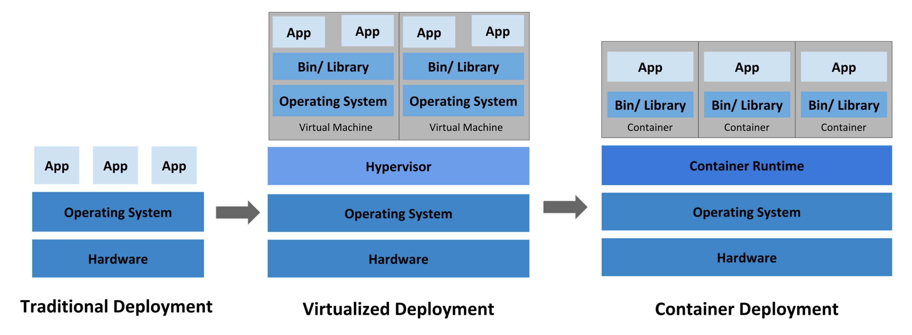
How Kubernetes works

Slide 16
Docker
docker hub - Docker Hub is the world's largest library and community for container images
Docker version
docker run hello-world – runs an image hello-world , it looks on our local system and if not there, then downloads from Docker Hub
docker run -d -p 80:80 --name webserver nginx
Docker ps –a : list containers
Docker images: list images
Docker stop container name
Docker rm: remove container
Docker rmi: remove image
docker run -it ubuntu bash: downloads Ubuntu image

Slide 17
Docker commands
docker build : build docker image
docker run : The docker run command creates a container from a given image and starts the container using a given command.
docker ps
docker pull : download an image from repository
docker push : upload an image to repository
docker rename

Slide 18
docker run –it ubuntu : install Ubuntu container and ready to run
in shell
once in shell: ls to list dir
docker run –it --name Marvel Ubuntu
docker ps: view containers
control P Q : exit shell
exit
docker attach Marvel: back to shell

Slide 19
NGINX
Nginx, pronounced like “engine-ex”, is an open-source web server that, since its initial success as a web server, is now also used as a reverse proxy, HTTP cache, and load balancer.
Some high-profile companies using Nginx include Autodesk, Atlassian, Intuit, T-Mobile, GitLab, DuckDuckGo, Microsoft, IBM, Google, Adobe, Salesforce, VMWare, Xerox, LinkedIn, Cisco, Facebook, Target, Citrix Systems, Twitter, Apple, Intel, and many more (source).
Nginx was originally created by Igor Sysoev, with its first public release in October 2004. Igor initially conceived the software as an answer to the C10k problem, which is a problem regarding the performance issue of handling 10,000 concurrent connections.

